Slide 1
Green Cleaning workshop for institutional settings
Right, Wrong, or Somewhere in Between: How You Clean Makes a Difference

Slide 2
Agenda
Green Cleaning workshop for institutional settings
Tuesday, November 15, 2011
Check-in and Pre-survey (5 min)
Welcome and Introductions (10 min)
What’s the problem with conventional cleaners? ( 35 min)
  Pre-survey health effects
  Disinfection, sanitization and cleaning – what’s the difference?
  Health & environmental problems associated with overuse and misuse of disinfectants
  MSDS sheet analysis from you worksite
Breakout Session - key challenges/concerns in their workplace (15 min)
Chemical-free Technology for Infection Control (35 min)
  Microfiber cloths, steam vapor, electrolyzed water, ozonated water
Green Cleaners (15 min)
  How good are they?
  Third party certification (DfE, Green Seal, etc)
  EPP List
  Where to get more info
Wrap Up & Next Steps (5 min)

Slide 3
What’s the Problem with Conventional Cleaners?
  Have any of you had adverse reactions to cleaning chemicals used in the workplace or at home?
  Health and environmental impacts of common cleaning product ingredients
    Health effects have you experienced from cleaners
      Surveys

Slide 4
Products and Health Effects
All purpose cleaner
Bleach
Ammonia
Oven cleaner
Kitchen counter cleaner
Toilet bowl cleaner
Tub and tile cleaner
Disinfectant
Window cleaner
Drain De-clogger (like Draino)
Air Freshener
Headaches
Dizziness
Nausea or vomiting
Trouble Breathing
Fatigue
Skin rashes or burns
Allergic reaction
Watery eyes/eye irritation
Nose irritation
Throat irritation
Asthma attack
Other (please describe)

Slide 5
How often do you do the following?
I read the label carefully before buying a cleaning product.
I open Windows before I use a cleaning product at home.
I wear gloves when I use a cleaning product at home.
I try to use as little of the cleaning product as possible to get the job done.

Slide 6
Cleaning, Sanitizing and Disinfecting
What’s the Difference?
  Cleaning - removes dirt/soil from surface
  Sanitizing - after washing and rinsing, a solution is applied to kill any remaining organisms on the surface
    Evaporates and leaves no chemical residue behind
  Disinfecting - after washing and rinsing, a solution is applied to surface to “catch & hold” microscopic airborne soils and kill targeted germs in the soil
    Leave a barrier/film behind on surface

Slide 7
Sanitizers
Reduces (kills) 99.9% to 99.999% of tested bacteria to levels considered safe for public health
Cannot have claims for killing viruses or fungi
Some products can be both a sanitizer and a disinfectant, depending on specified concentration
References: Infection Control for Dummies, J. Darrel Hicks, REH, http://www.epa.gov/iaq/glossary.html#S, http://www.epa.gov/iaq/glossary.html#D, and Source: Cleaning for Health, Inform, Inc, and presentation by Marcie Tidd on Disinfectants, Sanitizers, and Product Labeling, Overview of EPA’s Antimicrobial Registration Process, Women's Voices for the Earth Conference Call, February 4th, 2009
Notes:
7

Slide 8
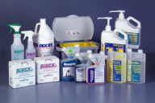
Disinfectants
Destroys 99.99% of all forms of microbial life, bacteria, virus’, but not necessarily their spores
Use on hard nonporous surfaces
8
8
Notes:
Porous surfaces have more places to hide.
8

Slide 9
Select Products: Disinfectant Claims
Select product based on need:
All disinfectants do not kill all types of microbes
EPA categorizes & registers products by their Disinfectant Claims based on what they kill:
Limited
Broad Spectrum, General
Hospital, Medical Use
9

Slide 10
What’s the Problem with Disinfectants
What are the health & environmental problems associated with overuse and misuse of disinfectants
  Quats
  Phenols
  Sodium hypochlorite
  Hydrogen Peroxide
  Alcohols
  Triclosan
  Chlorine

Slide 11
Disinfectants Are Not Cleaners - They are Pesticides!
The active ingredients of disinfectants are among the most toxic chemicals used in custodial work
Ingredient | Hazard Characteristics | User Health Effects | Surfaces
Quaternary Ammonium Chlorides | Corrosive | Eye & skin burns Asthma | Stains floor tile
Phenols | Toxic | Eye & skin burns Organ damage | Corrodes plastic surfaces
Sodium Hypochlorite (bleach) | Oxidizer Reactive | Eye & skin burns; Vapors are a respiratory irritant | Corrodes metal surfaces
Hydrogen Peroxide | Oxidizer Reactive | Eye & skin burns; Vapors harmful | Corrodes metal surfaces
Alcohols | Flammable | Absorb thru skin; Vapors are a respiratory irritant | Usually none
Triclosan | Toxic | Endocrine disruptor of unusual type | Hand soaps, toothpaste; infused into consumer products
Chlorine | Corrosive | Respiratory hazard, eye & skin irritation
References: Cleaning for Health, INFORM and : H. Temkin, Disinfectant Overkill Tempts Managers, http://www.cmmonline.com

Slide 12
Health Effects of Common Disinfectants: General
Skin, eye, respiratory irritation
Asthma & immune system hazards
Endocrine disruption/ reproductive hazards
Emerging subtle neural effects
  Disruption of neuronal cell-signaling systems
Indoor air quality:
  interactions with ambient air pollutants
Unknown: nano-silver

Slide 13
Health & Environmental Effects of Actives: Specific
Triclosan/Triclocarban
    Endocrine disruptor of unusual type
      Enhances effects of testosterone and estrogen in vitro
    Concentrates in biosolids, breaks down to dioxins with UV exposure (such as from use in crop fertilizer)
QACs
    Skin irritation: contact dermatitis; occupational asthmagen
    Immune adjuvant: enhances immune response to irritants
    Reproductive hazard: causes genetic damage to reproductive cells
Bleach
    Corrosive, respiratory hazard, eye & skin irritation
Aerosols generally
    Respiratory irritation enhanced by small particle size
    Less effective in terms of disinfection

Slide 14
Health and Environment: Asthma
Asthma:
  Known occupational hazard in medical settings from disinfectants
  2007 EU Respiratory study claims 1-in-7 cases of asthma can be attributed to use of household cleaning sprays and air fresheners; asthma has tripled in Europe in the past 30 years
  Pediatric asthma has increased 4.3% per year from 1980 to 1995
Indoor Air Quality (Nazaroff, UC Berkeley, CA Air Resources Board)
  Cleaning agents and air fresheners contain chemicals that are Hazardous Air Pollutants
    Exposures measured, and higher than expected
    Terpenes: pinenes,d-limonene, terpinene (pine oil); also aldehydes (e.g. citronellal, geranial in fragrances)
      Reactions with ambient ozone to create secondary hazards
    Hazards: poisonings from mixing bleach & ammonia
    Asthma, allergy, respiratory impacts from exposure to cleaning products, VOCs in home
      Glycol ethers, hydrocarbons

Slide 15
Disinfectant Selection: Ranking for Safety
Health: EPA Toxicity Rating (1-4)
Toxicity
Acute Toxicity Category | Signal Word Required
Category I | Danger/Poison
Category II | Warning
Category III | Caution
Category IV | Caution (or none required if all routes are Cat IV)
15
Notes:
Used on disinfectant labels.
We use in comparison chart.
15

Slide 16
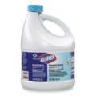
Select Products: Disinfectant
Hazardous Options - Bleach
Hazard Level
  CDC Disinfection Level - Intermediate Level
  EPA Toxicity Category - Category I
Claims
  most bacteria and some viruses
  registered as effective against HIV, HBV, H1N1 (Influenza A), MRSA, TB
Note: Can’t be stored longer than 3 months for disinfecting
When diluted, only effective as a disinfectant for 24 hours
Notes:
16

Slide 17
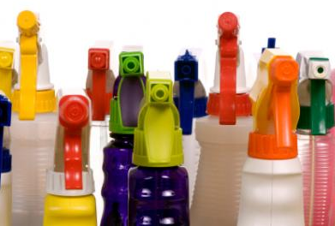
Activity
Participants identify specific chemicals in the products they use and discuss the health and environmental implications
  Handout on common cleaning chemical ingredients - Inform

Slide 18
Bathroom Scenario
People have heard all these stories about all the germs in bathrooms
  What is a good bathroom cleaning?
  In an institutional setting, using acidic toilet bowl cleaner "feels" so much safer and cleaner – is it?
  Lysol spray in air and on hard surfaces – Is it needed? Does it work?
  What if your worksite is cleaned 1X/week – what is best practices in the interim?

Slide 19
Examples of Hazardous Ingredients in Cleaning Products
Product Type | Hazardous Ingredient | Hazardous Properties | Health Impact
Carpet Spotter Glass Cleaner Restroom | Tetrachloroethlene | Chlorinated solvent | Reproductive Hazard Carcinogen
Carpet Spotter | Hydro-fluoric acid | Corrosive | Burns, could cause permanent damage
Carpet Cleaner Restroom Floor Stripper | Ethanolamines (Di, Tri, Mono) | Corrosive Combustible | Suspected Carcinogen Toxic to person/fetus Severe irritant CNS depression
Carpet Cleaner Glass Cleaner Floor Stripper | 2-Butoxyethanol | Flammable solvent | Toxic to person/fetus

Slide 20
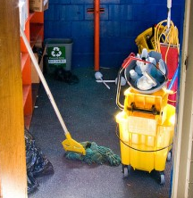
Breakout
Discuss key challenges/concerns in the workplace
  When disinfection is necessary
  Proper disinfecting techniques
  The criteria for selecting safer disinfectants

Slide 21
Written Procedure Should Provide Guidelines to the Following:
Why disinfect?
What surfaces and objects need disinfection?
What is the schedule for disinfection?
What are the least toxic and most effective products, processes, and equipment that can be used?
Who should be doing the disinfecting?
What information, training, and PPE do personnel need?
How should workers and building occupants be protected during the process?
What is the proper way to manage disinfectants and equipment?
How should disinfectant products and by-products be disposed of?

Slide 22
Why Disinfect?
Determine whether it is likely that the surface will come in contact with broken skin or mucous membranes.
If a surface is contaminated with microbes, but no one is touching it, what would be the point of disinfecting it?
Routine vs. Outbreak
High Risk and High Touch areas

Slide 23
Factors that Compromise Effectiveness of Disinfectants
Type of germ that you want to kill
Materials on the surface to be disinfected
Cross contamination issues
Concentration and quantity of product
Contact time
Appropriate temperature
Compatibility and affects on fabric and metal
Shelf life

Slide 24
Areas of Concern
Cleaning, sanitizing and disinfecting not the same
Lack of information on newer chemical-free technologies
Years of using the same product – uncomfortable changing
Perception that environmentally preferable cleaners are less effective
Lack of training on correct usage and storage of chemicals
Staff bringing their own supplies to use at the workplace
Hard to read MSDS sheets
  They don’t have all the info anyway
  Ask for a Technical Data Sheet

Slide 25
“Chemical-free” Technology for Infection Control
Microfiber cloths
  How they can clean better
    Fibers are split to expose a higher surface area
    Leaves room for things like dirt and grime to fit into these pockets
    Unlike ordinary cotton towels that move, or push, the dirt and dust from one point to another, Microfiber actually gets underneath the dirt and lifts it from the surface
      The fibers collect the bacteria and dirt
microfiber
Traditional fiber

Slide 26
Microfiber Study Results
UC Davis Medical Center study found that initiating a microfiber mopping system resulted in the following cost benefits:
  60% lifetime cost savings for mops
  95% reduction in chemical and water usage associated with mopping tasks
  20% labor savings per day
The Sustainable Hospitals Project at the UMass Lowell found similar cost savings

Slide 27
Microfiber Cleaning
Do not use soaps, detergents, cleaners or degreasers
  Chemicals will prevent the towel from working
When towel gets dirty rinse with cool to lukewarm water
  Swish the towel around in the water
  Then dunk it in and out of the water several times
Hang it to dry and it can be re-used

Slide 28
Microfiber Cleaning
When towel gets really dirty and won’t rinse clean, the towel can be machine-washed
  NEVER use hot water with a microfiber towel
    Fibers will shrink and not work as well (the tiny channels close up)
NEVER expose the microfiber towel to heat
  Use the coolest setting on the dryer
  Don’t iron it
  Don’t use it on hot objects
NEVER wash a microfiber towel with regular terry cloth towels, socks or other items that shed a lot of lint
  Microfiber towel will pick up the lint from cotton towels and get clogged up

Slide 29
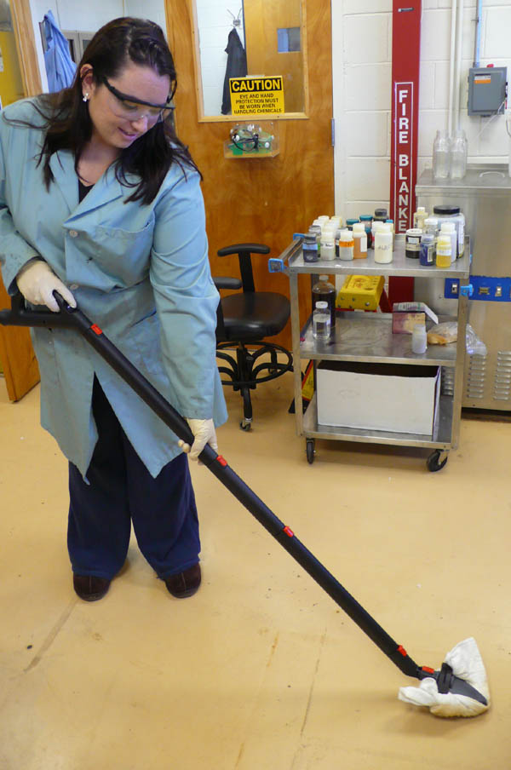
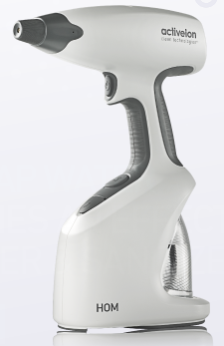
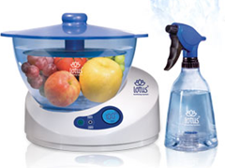
“Chemical-free” Technology for Infection Control
Steam-vapor
  Cleans wide range of surfaces and soils
  Disinfects well
  Uses only water
Electrolyzed Water
  Cleans light soils well
  Potential for disinfecting - testing on-going at TURI Lab
  Uses only water
Ozonated Water
  Cleans some soils well
  Testing for disinfecting planned at TURI Lab
  Uses only water

Slide 30
Green Cleaners
How good are they?
Where to get more information
  Third party certification
  EPP List
  TURI Lab

Slide 31
How Good Are They?
10-15 Years ago - hit or miss if they worked
  Created negative image for green products
Green cleaners of today are much improved
  On par or exceed traditional products
  Still need to pilot test products to see if they work for you
    TURI Lab can help
      In the lab
      In the field

Slide 32



Third party certification
Green claims
  How real are they, who do you trust?
Independent verification of product safety and performance
  Green Seal
    www.greenseal.org
  EPA Design for the Environment
    www.epa.gov/dfe/
  Ecologo
    www.ecologo.org/

Slide 33
Environmentally Preferable Products Lists
State generated contract helps take the guess work out of product selection
  The primary goal of the program is to use the Commonwealth's purchasing power to reduce the environmental and public health impact of state government

Slide 34
Massachusetts Executive Order #515
Establishing an Environmental Purchasing Policy
  Requires all Executive Departments to reduce their impact on the environment and enhance public health by procuring EPPs:
    Whenever such products and services are readily available
    Perform to satisfactory standards
    Represent best value to the Commonwealth

Slide 35
MA State Contract FAC59
Green Cleaning Products, Programs, Equipment and Supplies
Eligible Entities:
  Cities, towns, districts, counties and other political subdivisions
  Executive, Legislative and Judicial Branches, including all Departments and elected offices therein
  Independent public authorities, commissions and quasi-public agencies
  Local public libraries, public school districts and charter schools
  Public hospitals owned by the Commonwealth
  Public institutions of higher education
  Public purchasing cooperatives
  Non-profit, UFR certified organizations that are doing business with the Commonwealth
  Other states and territories with no prior approval by the State Purchasing Agent required
  Other entities when designated in writing by the State Purchasing Agent

Slide 36

MASS EPP Contact
Contract Manager:
  Marcia Deegler, Director, Environmental Purchasing
  Operational Services Division
  One Ashburton Place, Room 1017
  Boston, MA 02108
  Phone: 617-720-3356; Fax: 617-727-4527
  Email: marcia.deegler@state.ma.us

Slide 37

TURI Lab
Laboratory Performance Testing
  Side by side comparisons
  Controlled testing
  Ball park idea as to how they work
Testing in field
  Work with end users doing the work
  Real world testing
  Finds out if the product really will work for you

Slide 38
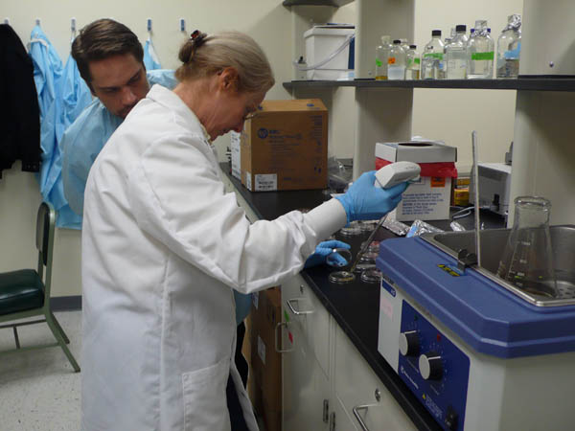
Disinfecting Questions
Partnering with Clinical Science and Nutritional Lab Department at UML
  Answering many of the questions, myths and truths about disinfection
    If you have concerns over disinfection procedures, chemicals or anything else, let us know

Slide 39
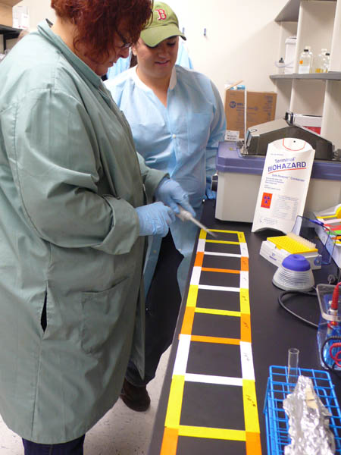
The Partnership
TURI Lab
  We know cleaning
  We know what we don’t know
    Disinfection
UML Clinical Lab Science
  They know disinfection
  They know that we know about cleaning
Together we know a lot about cleaning and disinfecting
  What we don’t know, we will test to find out

Slide 40
The Scope
Establishing protocols for cleaning and disinfecting
Piloting test methodologies for non-chemical disinfecting
Begin to answer the questions from workgroup

Slide 41
Testing Underway
DIY Recipes
Electrolyzed water
“Greener” chemical disinfectants
Microfiber
Steam Vapor
“Real-time” analytical tool comparisons

Slide 42
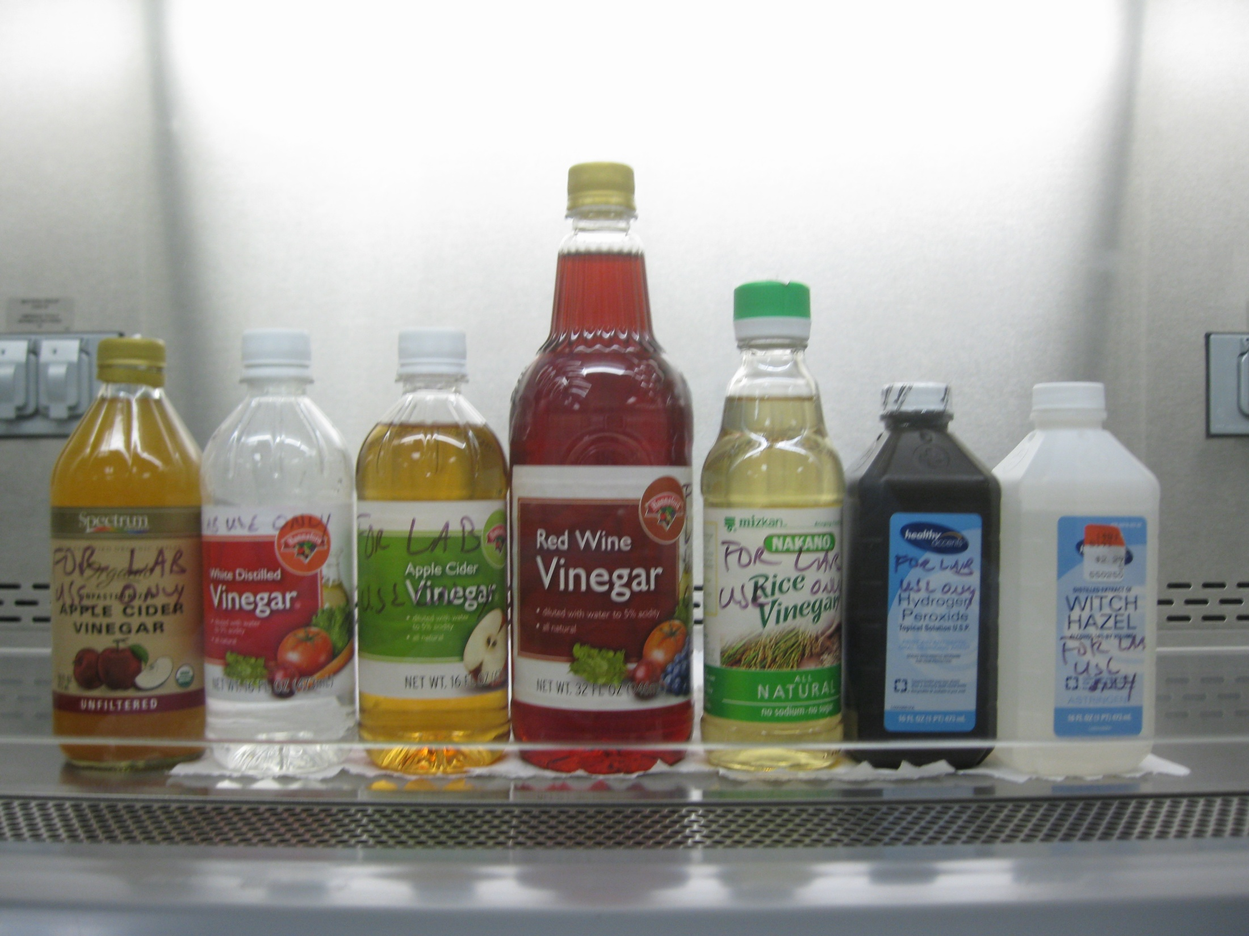
Do-It-Yourself Disinfection
Vinegar
  Contact time
  Concentration
Notes:
Unpasteurized Apple Cider (not used due to natural bacteria)
White distilled
Pasteurized Apple Cider
Red Wine
Rice
Off the shelf rubbing alcohol
Witch Hazel (no data to date?0

Slide 43
Vinegar Results To Date
100% White Distilled Vinegar
  5 minutes: 6.12 log reduction
  3 minutes: 5.97 log reduction
  1 minutes: 5.97 log reduction
  30 seconds: 5.28 log reduction
Other vinegars
  5, 3, 1 minute: 6.12/5.97 log reduction

Slide 44
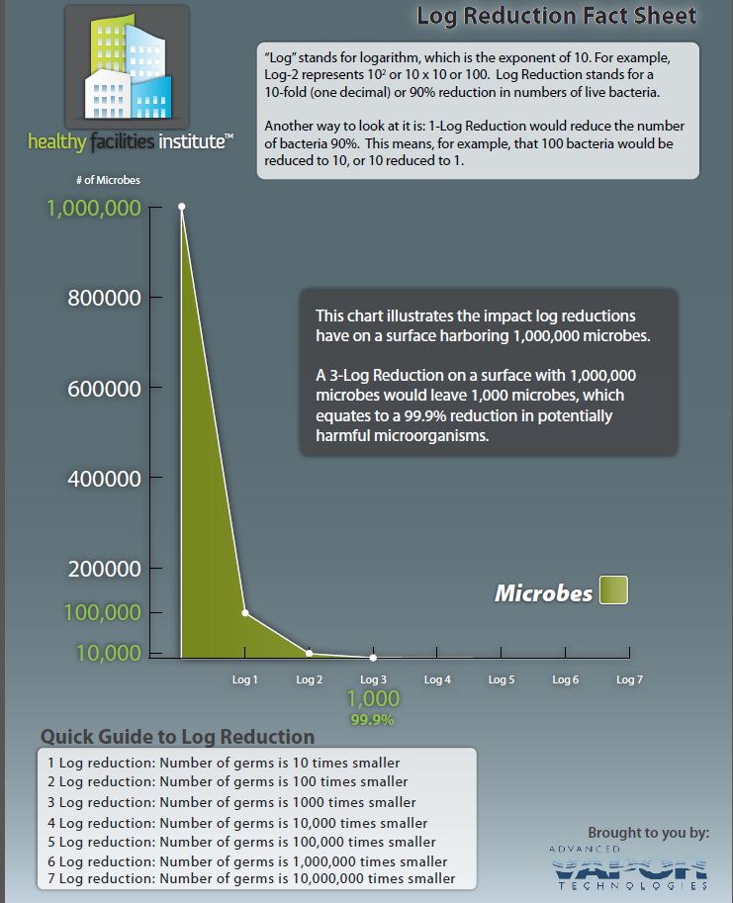

Slide 45
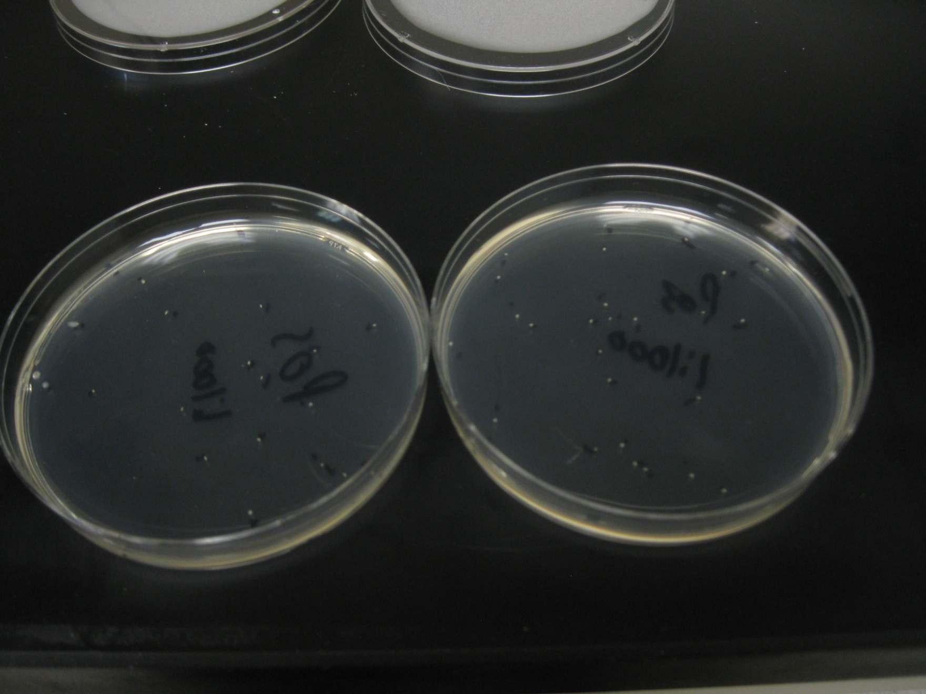
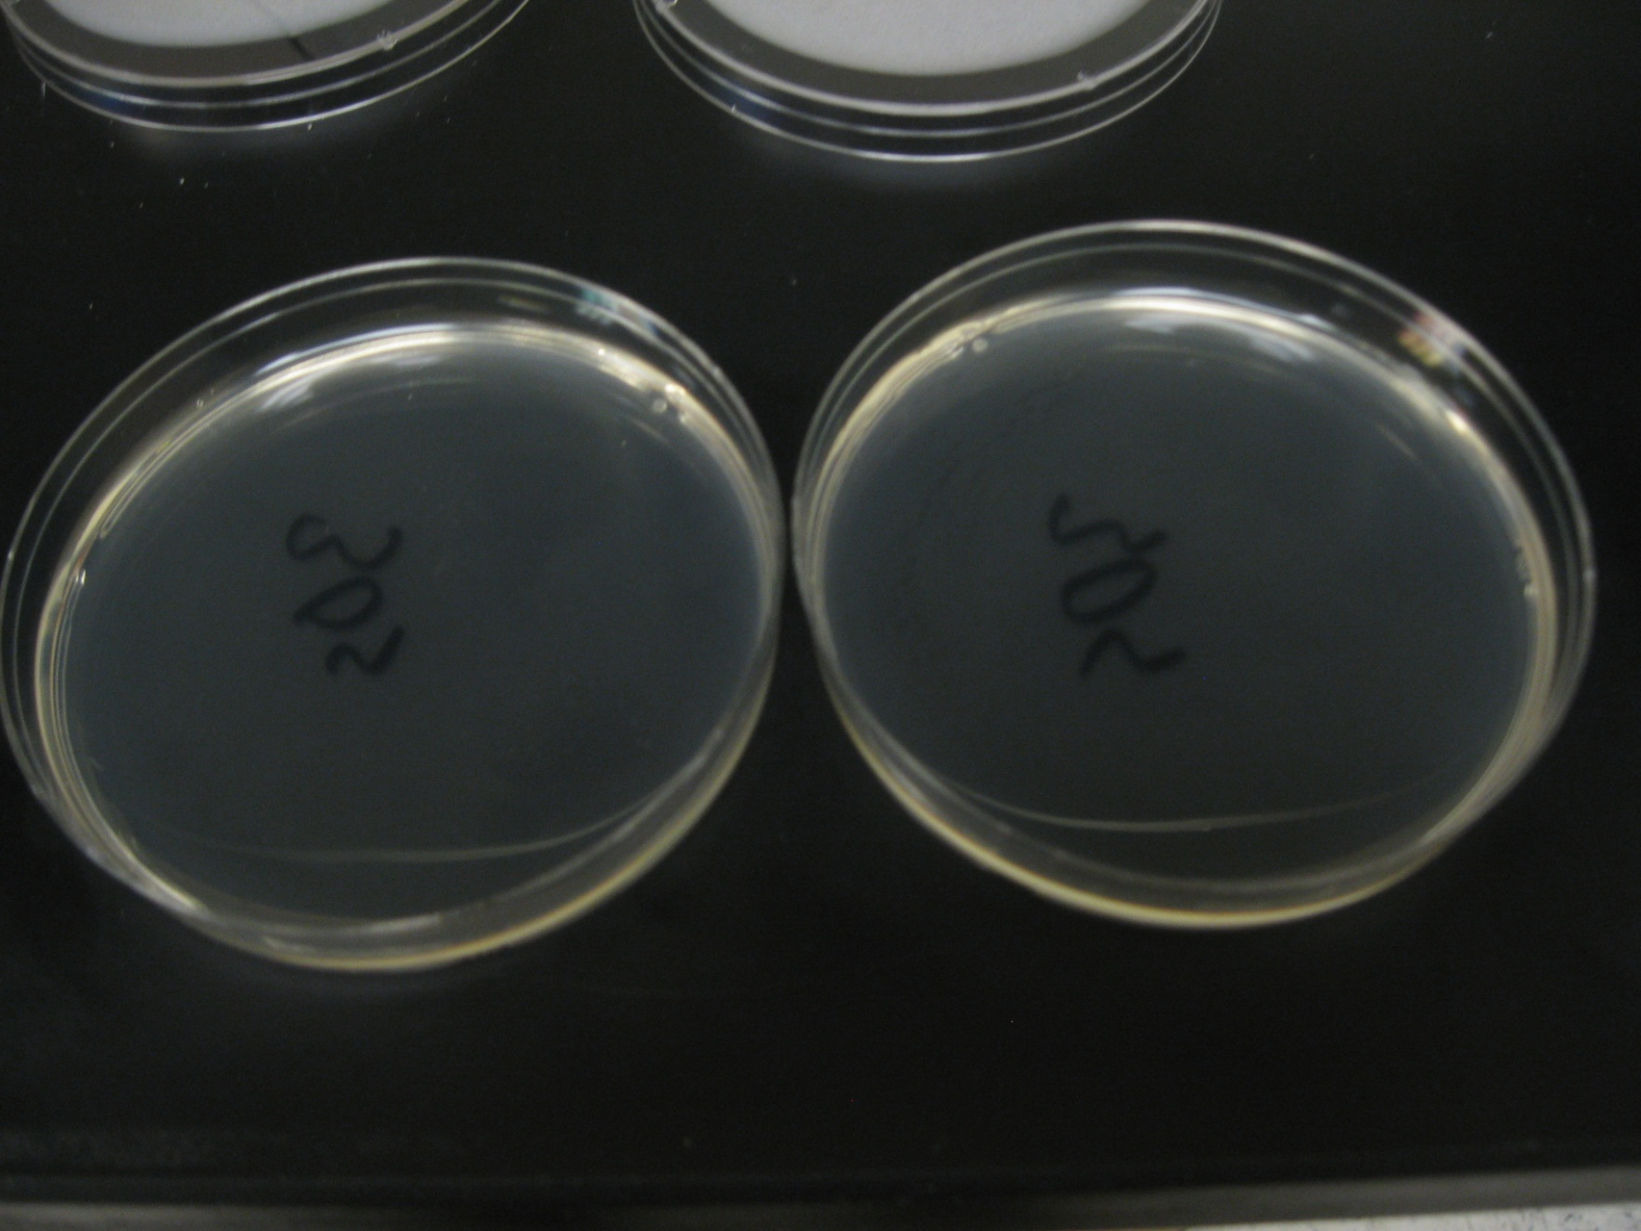
Vinegar Results
Positive Control 30 Seconds
Notes:
This is a pour plate so the colonies are tiny- under the agar surface
Positive control is a 1:1000 dilution
Test is WDV at 30 seconds contact time

Slide 46
Vinegar Future Tests
Reduce contact time to 10 – 15 seconds
Repeat minimum time with other vinegars
Dilute vinegar to find lowest concentration
Other DIY recipes based on vinegar
  Four Thieves Vinegar

Slide 47
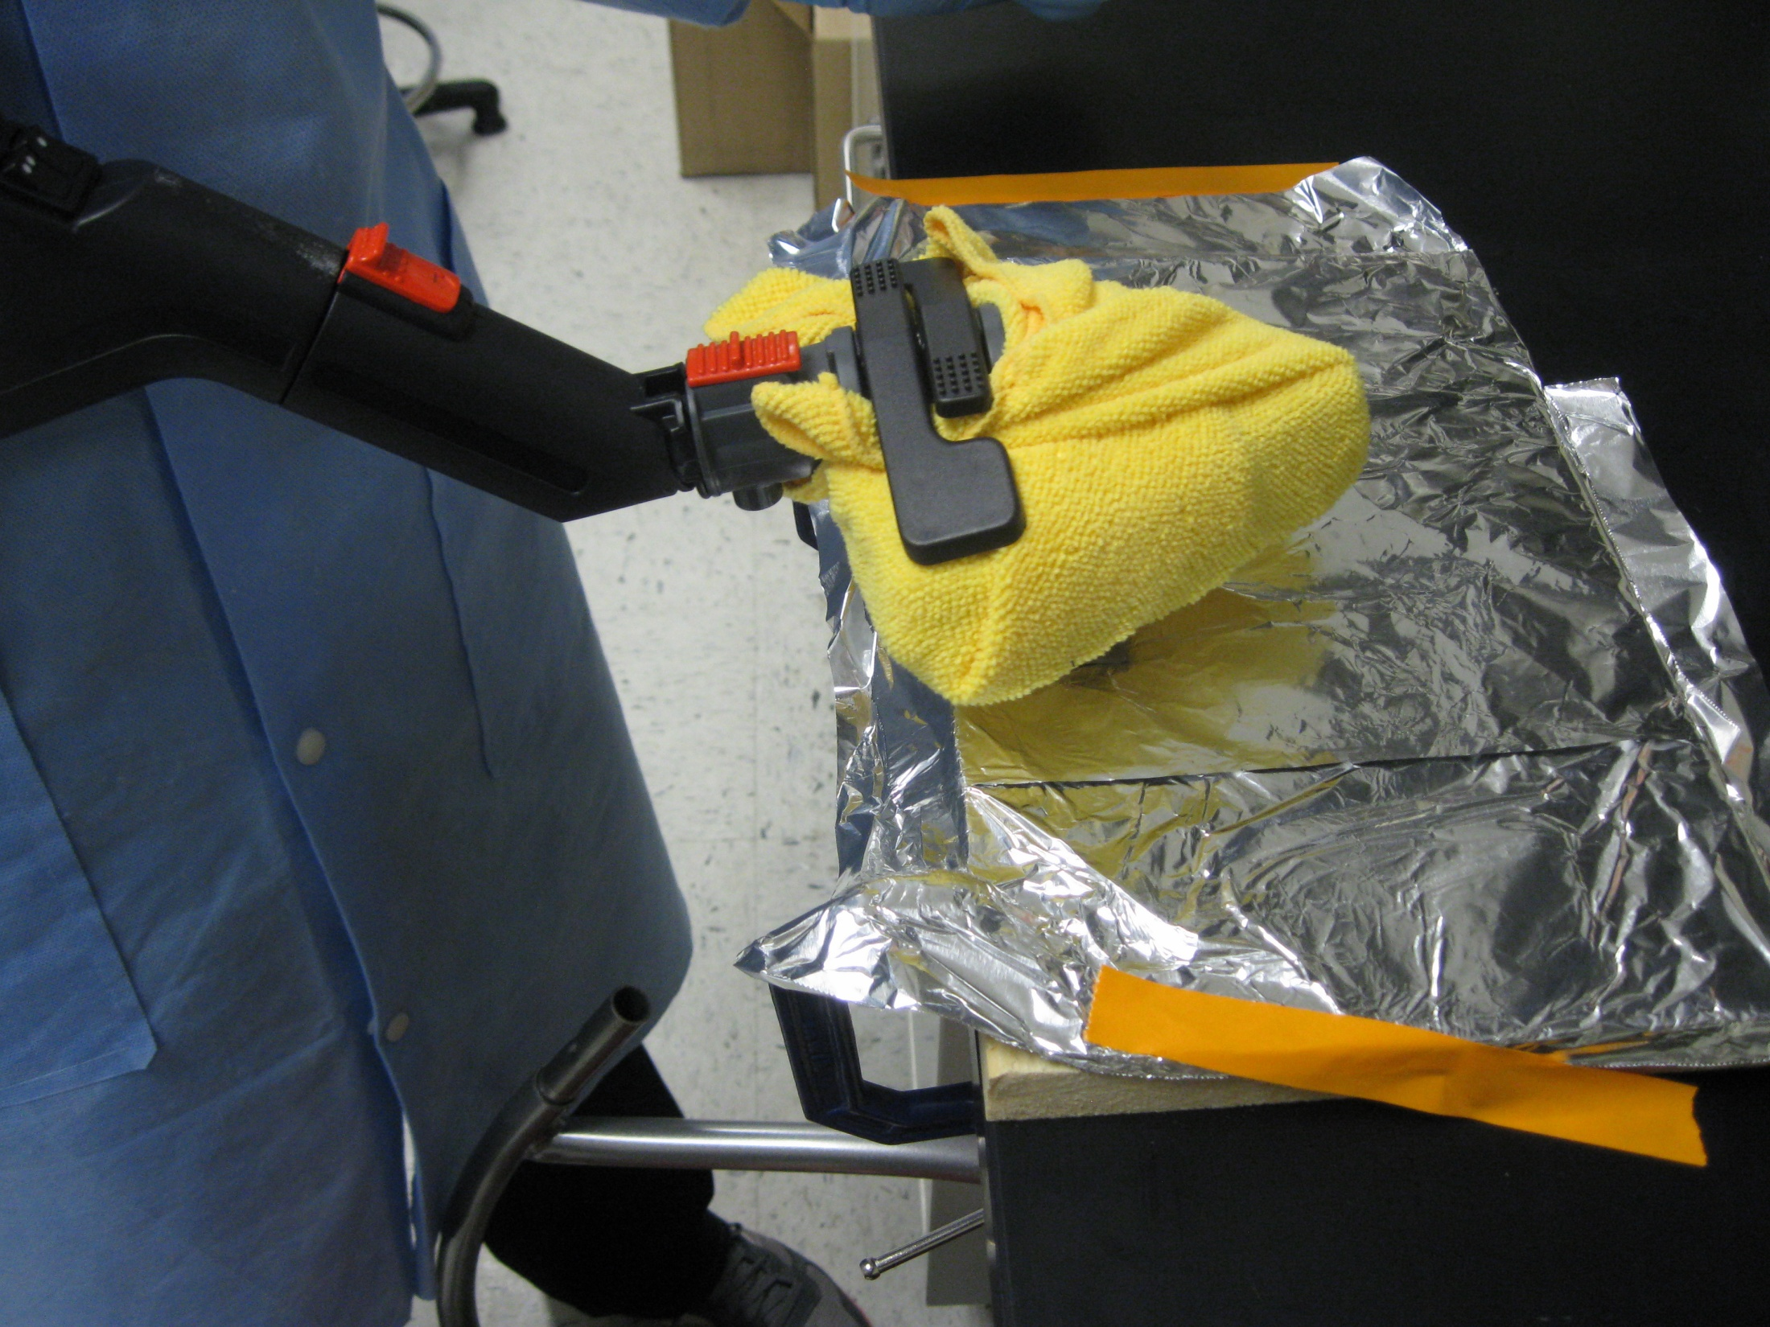
Advance Vapor Technologies MondoVap 2400
Cotton Towels
Microfiber Cloths
No Fabric Softener
Liquid Fabric Softener
Dryer Sheets

Slide 48
AVT Results To Date
Log Reduction | Cotton Towels | Microfiber Towels
Correctly Laundered | 3.82 | 3.30
Liquid Fabric Softener | 6.50 | 6.79
Dryer Sheets | 6.50 | 6.79

Slide 49
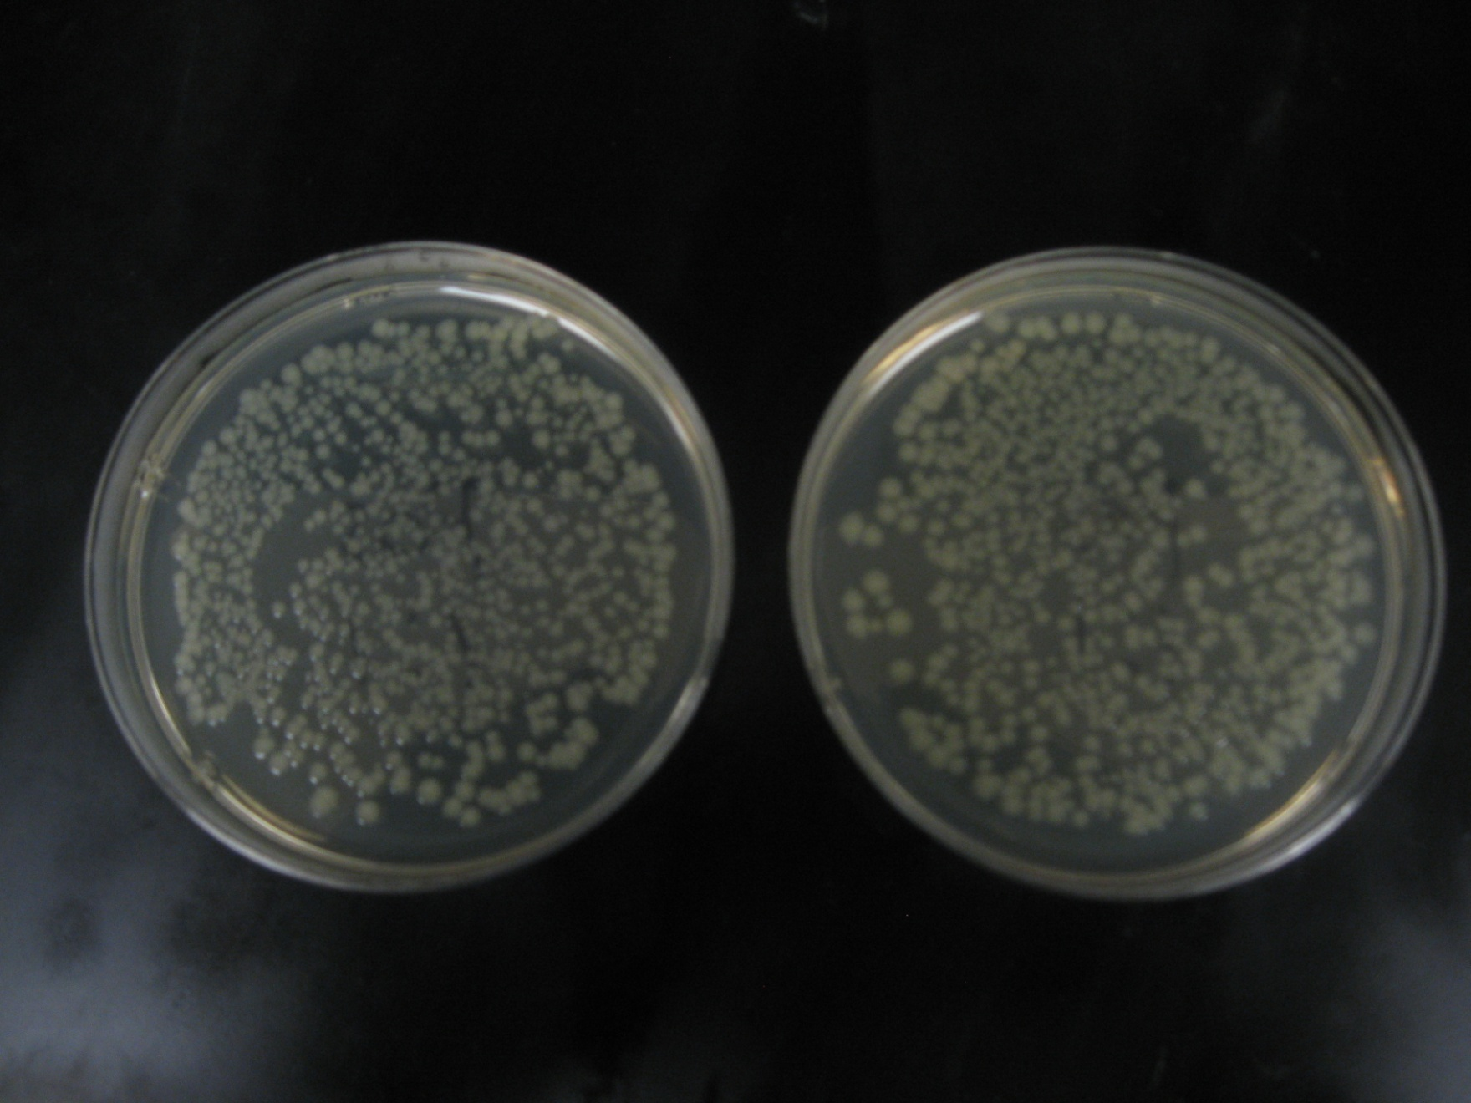
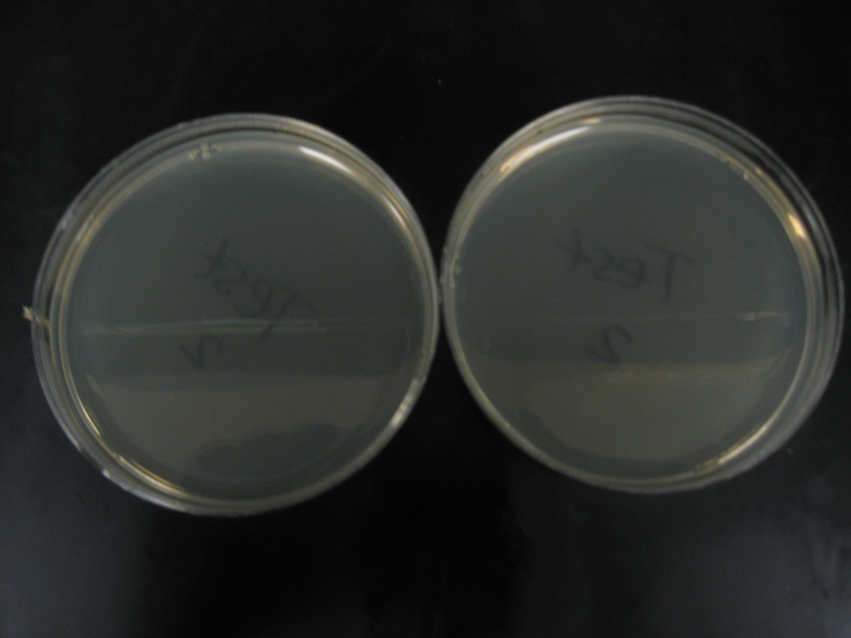
AVT Results To Date
Positive Control Microfiber Cloth
Notes:
Spread plates, larger colonies
Positive control, 1:1 (further dilutions plated for counting)
Test is MF cloth washed with liquid fabric softener

Slide 50
AVT Future
Additional Repeats of Current Runs
No Towel at all
No Filler Pad

Slide 51
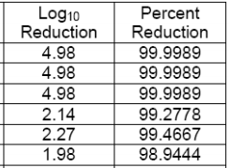
Ozonated Water System
30 second contact time
e.Coli
Fruit and Vegetable Antibacterial Wash Test
MICROBIOTEST, INC.
        Tomato
        Grape

Slide 52
Let Us Know If You Need Help
Toxics Use Reduction Institute
UMass Lowell
1 University Avenue
Lowell, MA 01854
fax: 978-934-4962
TURI website: www.turi.org
Cleaning Database: www.cleanersolutions.org
Blog: http://turicleanbreak.blogspot.com/
Jason Marshall, ScD
Laboratory Director
Jason_Marshall@uml.edu
(978)934-3133
Skype: drclean14
Heidi Wilcox
Field Implementation Specialist
heidi@turi.org
(978)934-3249
Skype: heetmeizer

